Slide 1
Git Basics

Slide 2
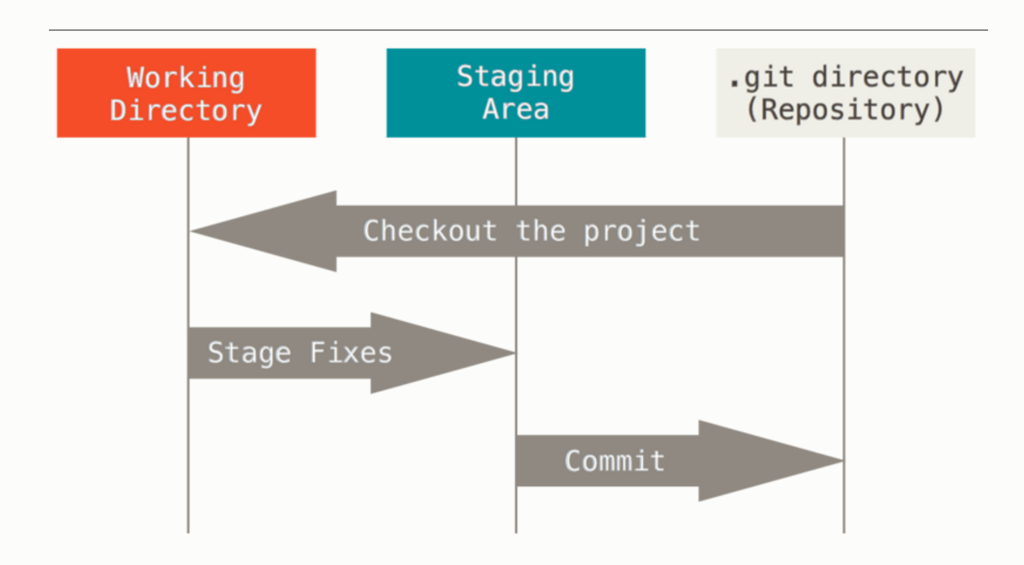
Local Repo

Slide 3
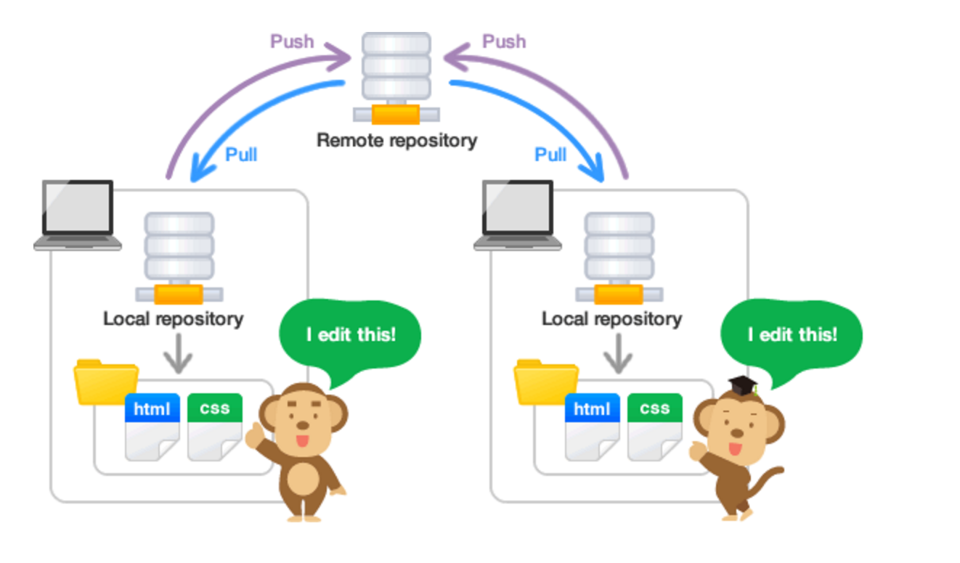
Local and Remote Repo

Slide 4
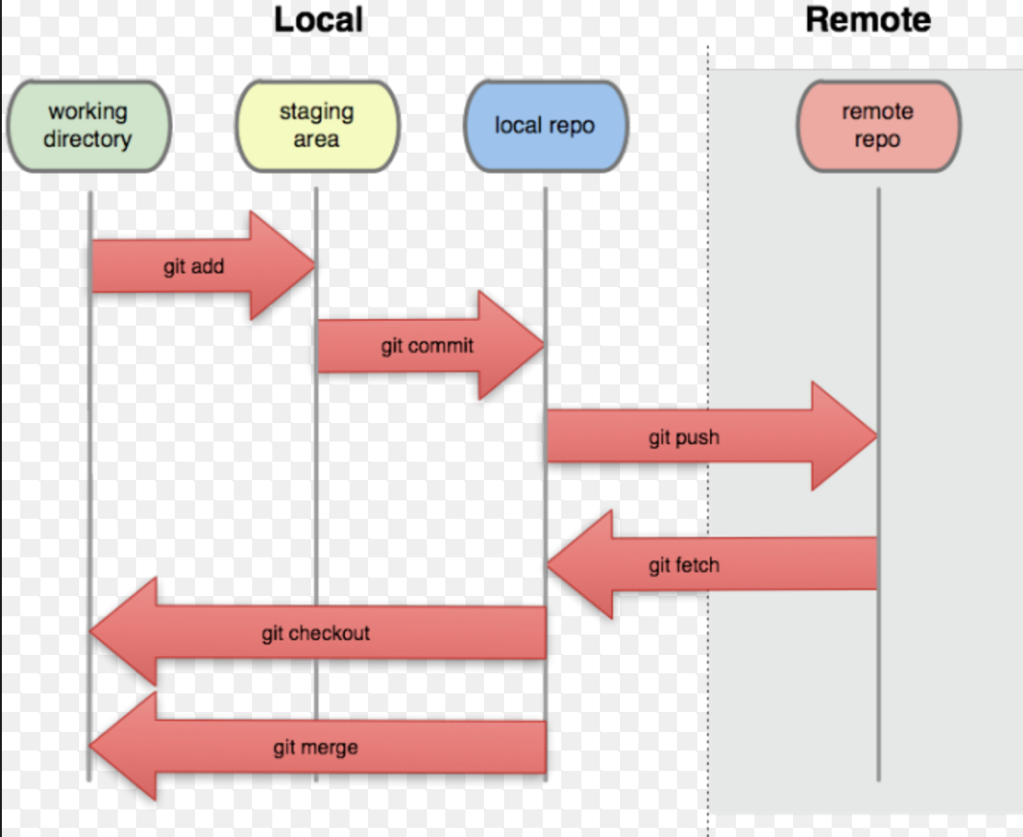
Pushing and Pulling

Slide 5
Git a repo
git clone reponame

Slide 6
See where you are
Git status

Slide 7
Create a new local branch
git checkout –b mybranchname
git branch –a (Shows all local and remote branches)
git checkout without the b will checkout an existing branch

Slide 8
Make a change
Add a file or modify a file
“git add --all” will stage all files for a commit
“git add --p” will allow you to selective stage code for a commit on a modified file

Slide 9
Commit your change to local repo
“git commit –m “my commit message”

Slide 10
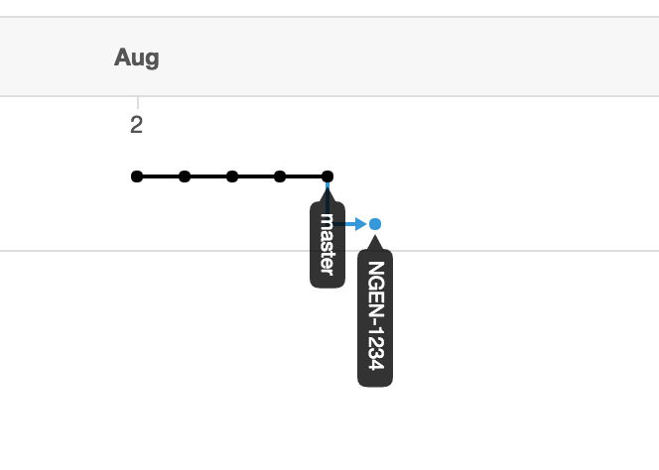
Push your new branch to remote origin
“git push origin BRANCH”
View branches in GitHub:

Slide 11
Make another bad change
Before you stage “git checkout filename”
After you stage, “git reset”
After you commit, If your excess commits are only visible to you,
you can just do ”git reset --hard origin/branch” to move back to where the origin is.

Slide 12
Merge to Master
Pull in master to make sure there will be no merge conflicts
Go to GitHub to issue a pull request
When QA is ready to test the story, they can merge the branch to master
You can do CRs here

Slide 13
Revert the commit
Can revert in github
Or git revert Commit Hash -m how many commits previous

